Slide 1
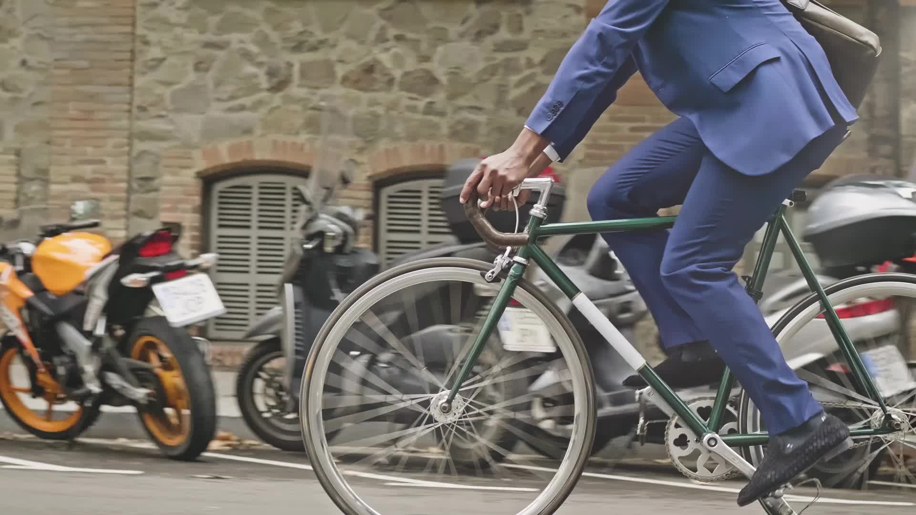
Bike Sharing Assignment
Author : Jagadish Janakiraman
Date : 1/17/2022

Slide 2
Demand Prediction
Top 10 least popular stations
San Jose Government
Center Broadway at Main
Redwood City Public Library
Franklin at Maple
San Mateo County Center
Redwood City Medical
Center Mezes Park
Stanford in Redwood City
Park at Olive
Santa Clara County Civic Center
Top 10 Nearest Stations
Station 1 | Station 2 | Distance In KM
San Francisco Caltrain 2 (330 Townsend) | San Francisco Caltrain (Townsend at 4th) | 0.000000
Palo Alto Caltrain Station | University and Emerson | 0.185112
San Jose City Hall | MLK Library | 0.188775
Commercial at Montgomery | Washington at Kearney | 0.220652
Redwood City Caltrain Station | San Mateo County Center | 0.242816
2nd at Folsom | Howard at 2nd | 0.258114
South Van Ness at Market | Market at 10th | 0.266381
Clay at Battery | Davis at Jackson | 0.310304
San Francisco City Hall | Golden Gate at Polk | 0.312825
Temporary Transbay Terminal (Howard at Beale) | Beale at Market | 0.328881

Slide 3
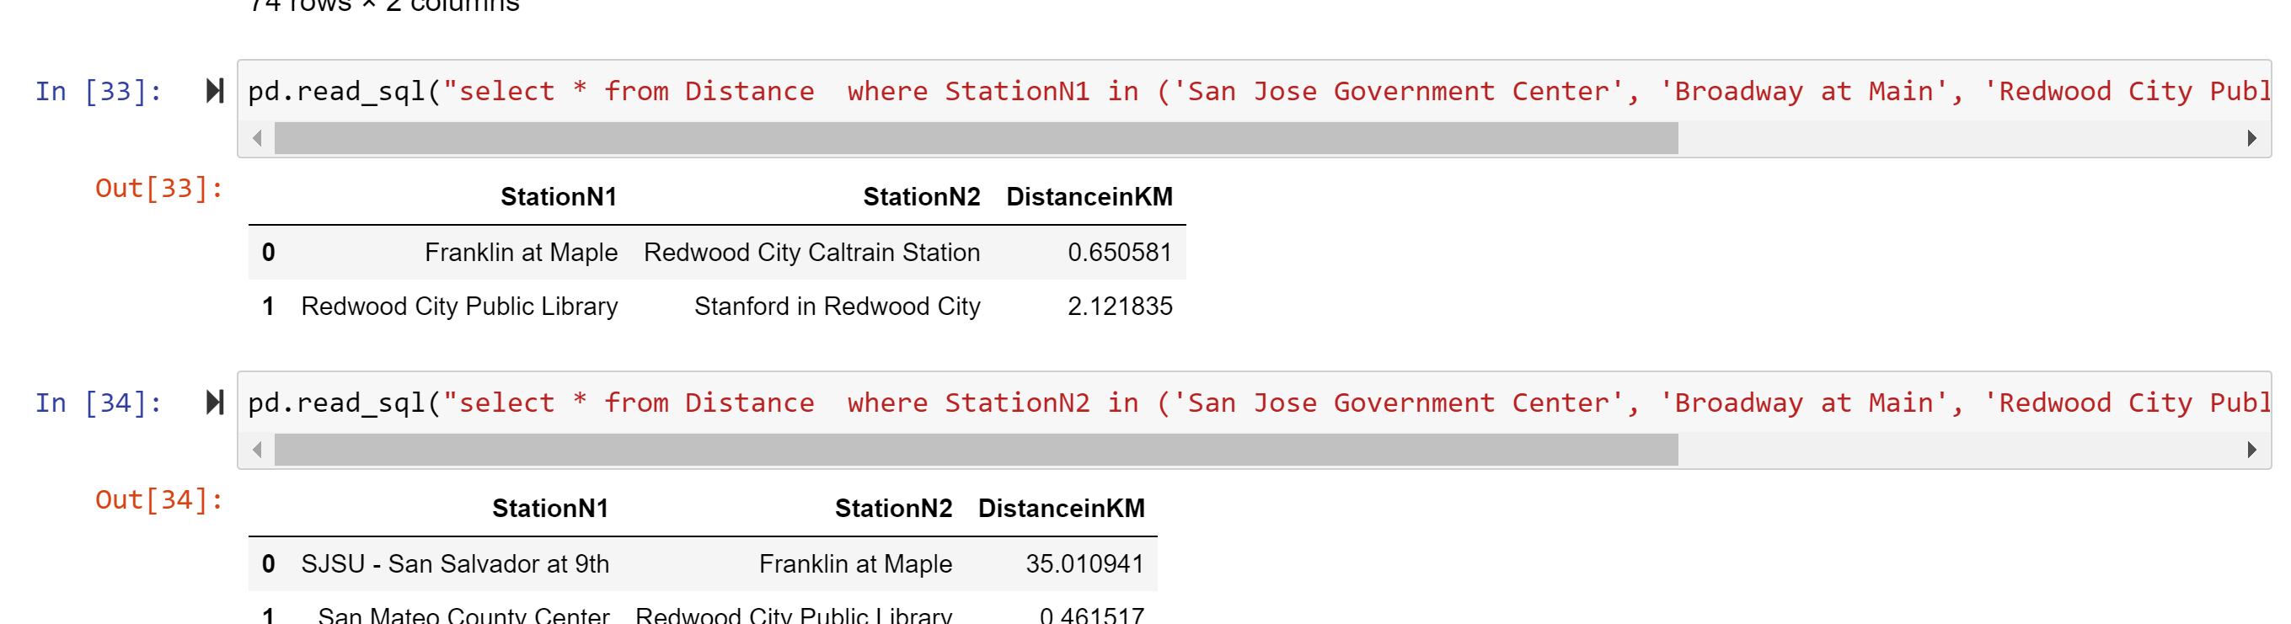
Demand Prediction
Recommending to close the following 3 stations -
"Franklin at Maple" can be closed as it is less popular than Redwood city and these two stations are nearby
"Redwood City Public Library" can be closed as it is less popular than "Standford in Redwood City“ and they are close by
"San Mateo county center" can be closed as it is less popular, and it is close to "Stanford in Redwood City"

Slide 4
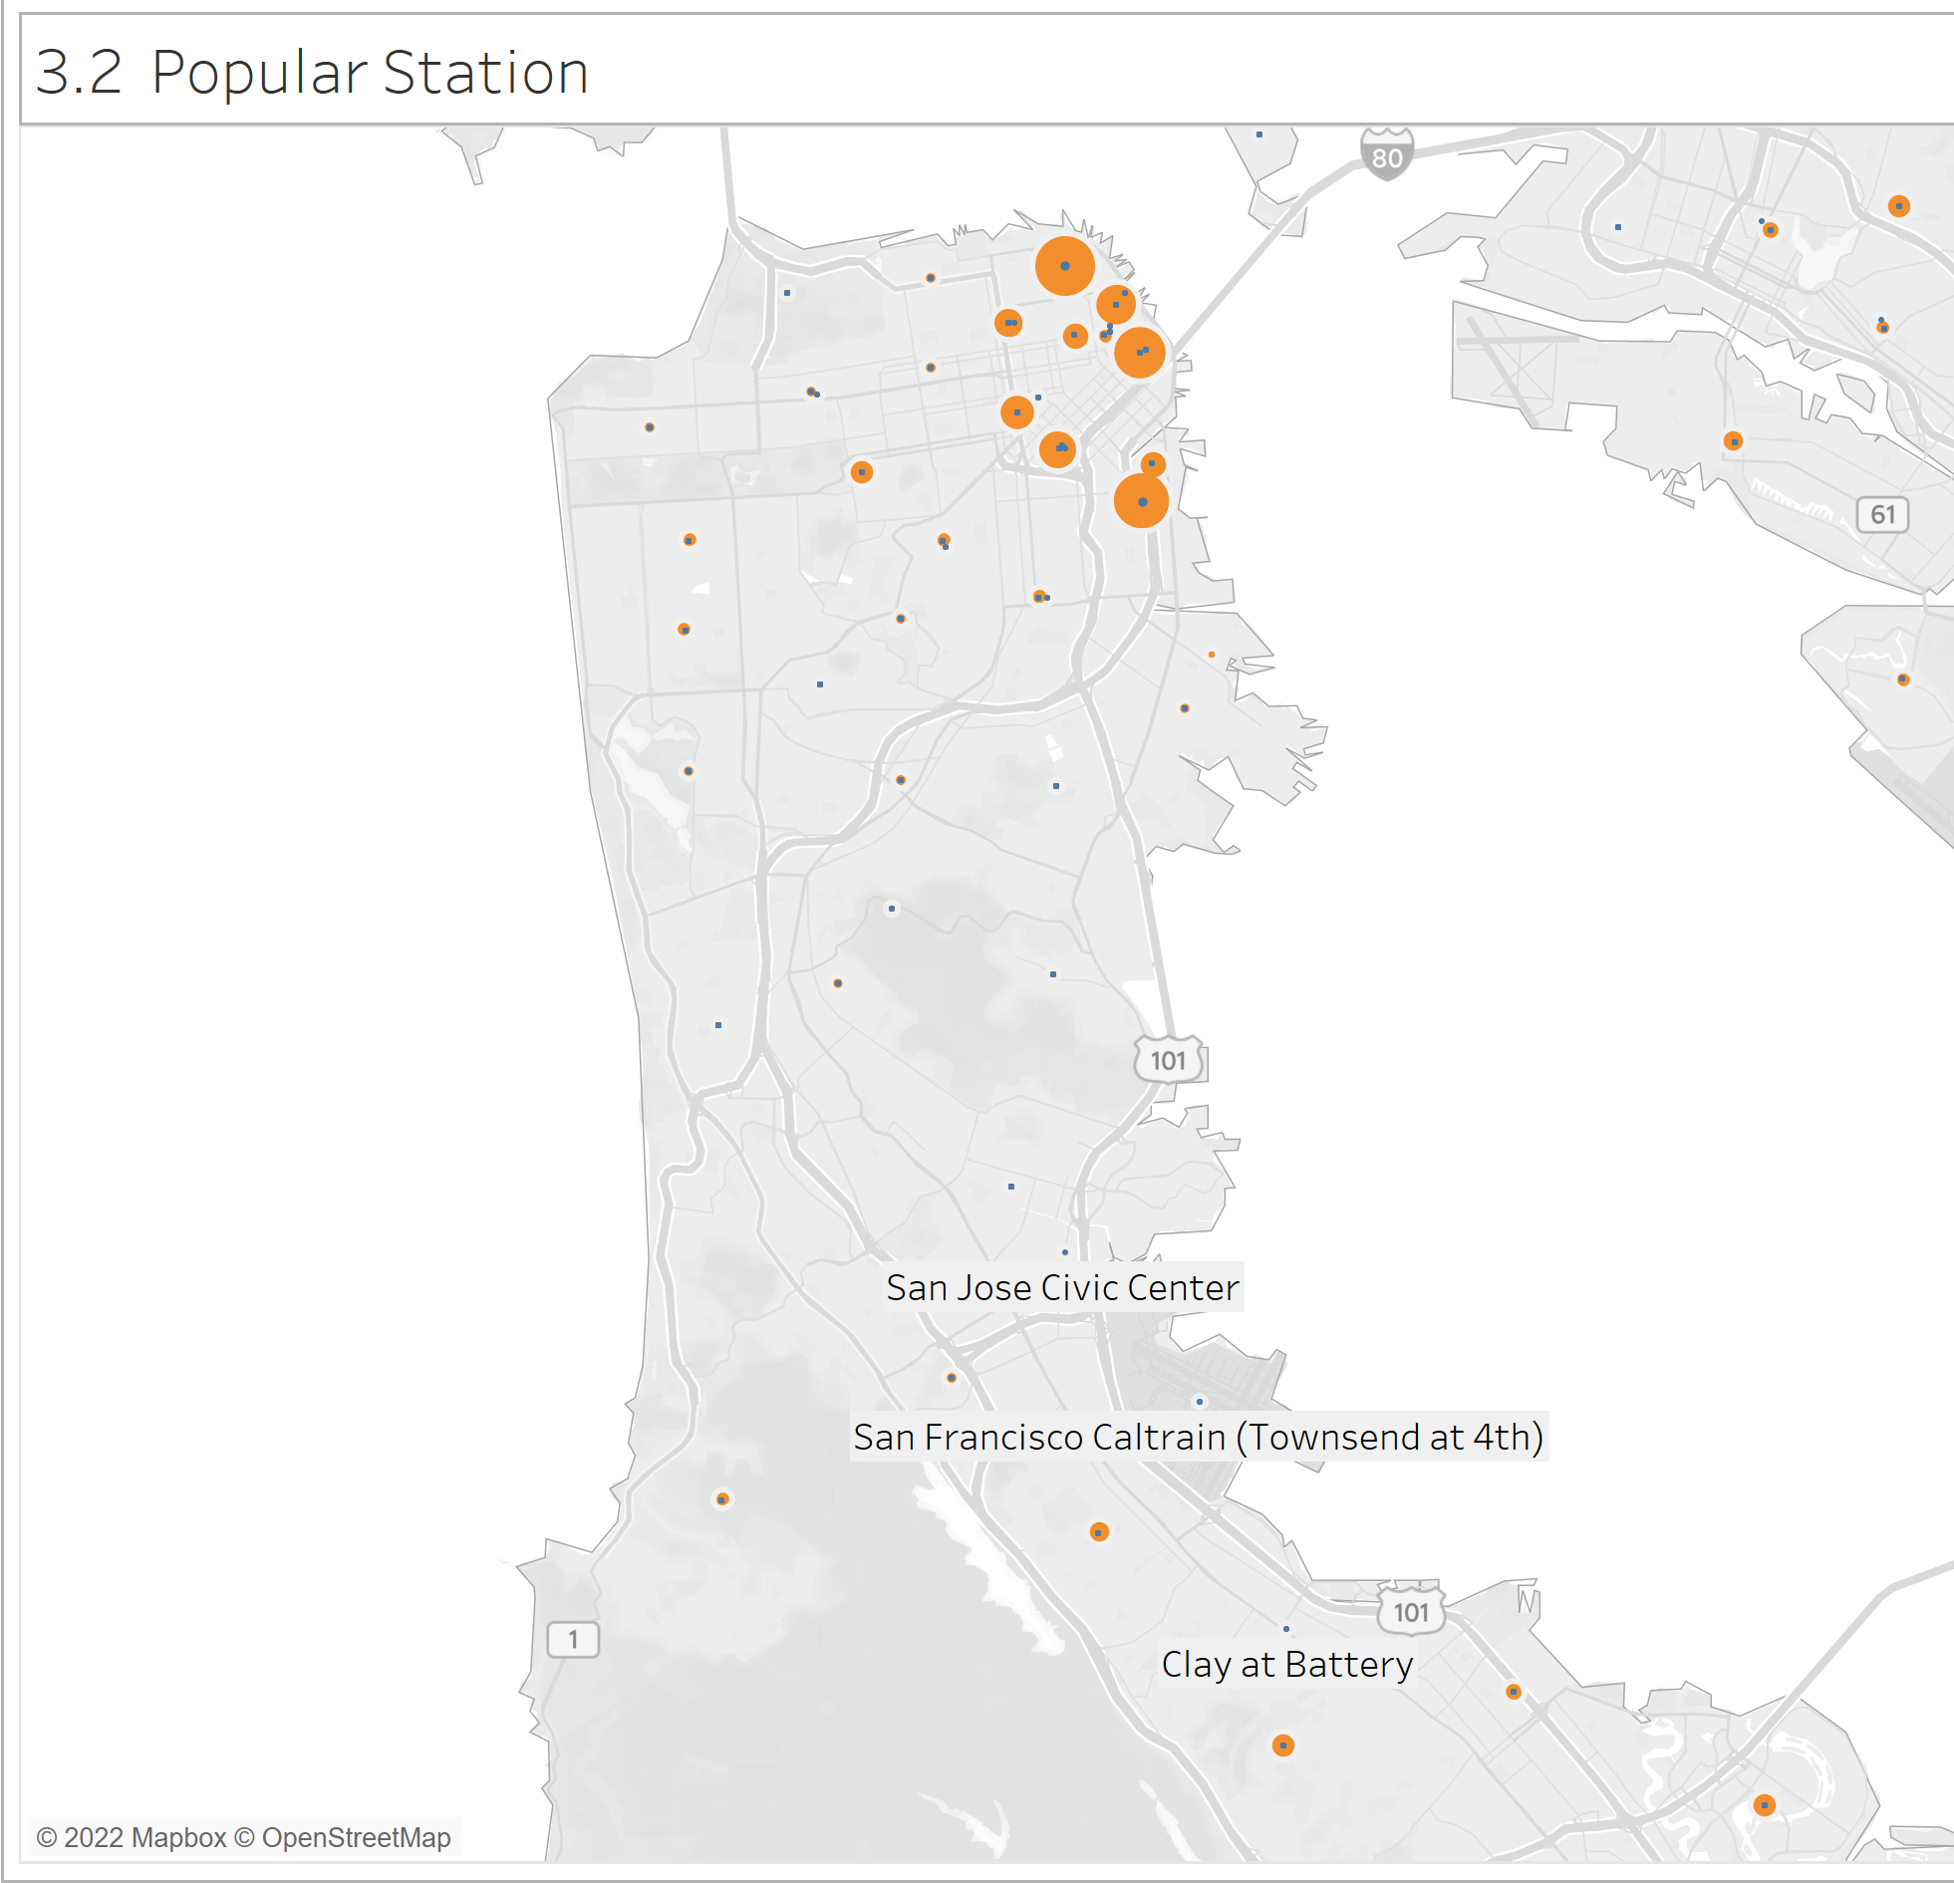
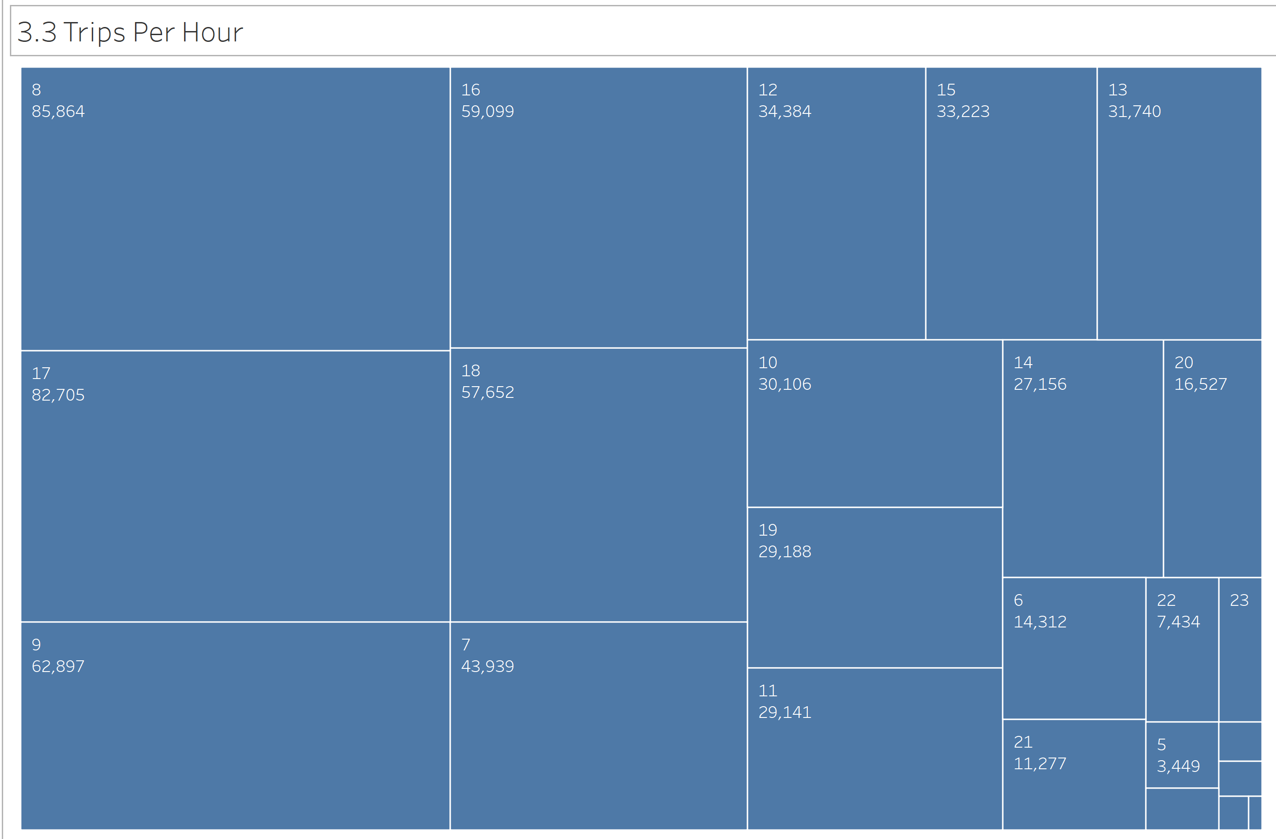
Optimizing Operations
North of San Francisco is the most popular station (shown with bigger circles). The peak business hours is from 7 AM to 9 AM and between 4 PM to 6 PM.
Recommendations is to keep more bikes available in the popular locations between the peak business hours.

Slide 5
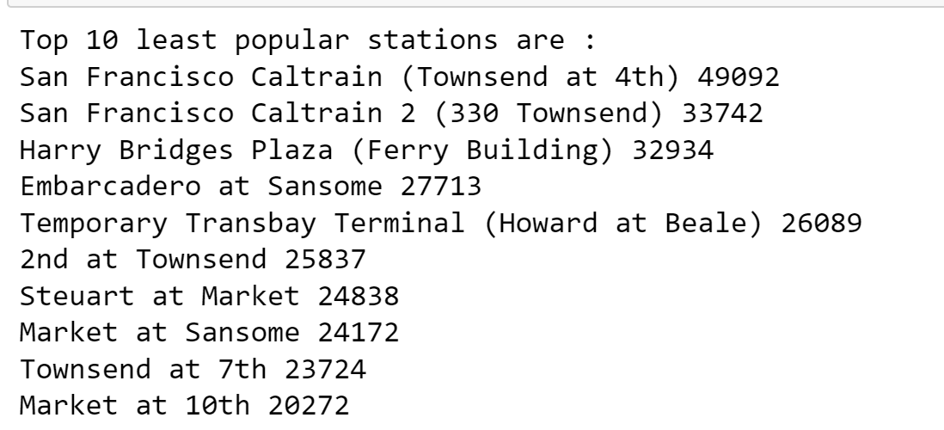
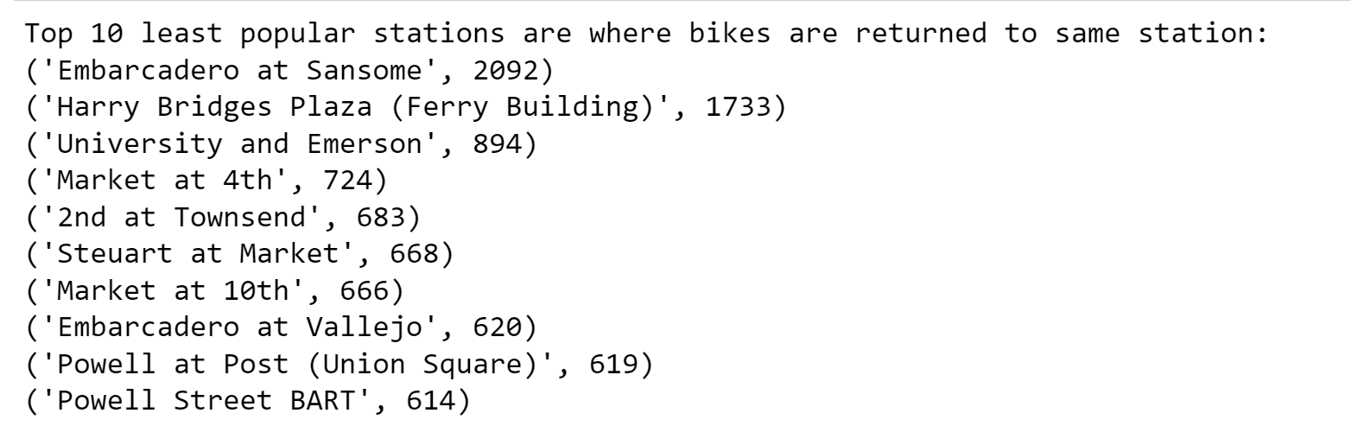
Couples bike
Recommendation is to do a Trial for couple bikes in TOP 4 popular stations.
The first four stations are very popular stations. So more users could be benefited.
The last two stations are popular and bikes are returned to the same location.
1. San Francisco Caltrain (Townsend at 4th)
2. San Francisco Caltrain 2 (330 Townsend)
3. Harry Bridges Plaza (Ferry Building)
4. Embarcadero at Sansome

